Slide 1
Attempts at Peace

Slide 2
Arafat accepts 242 & 338 (1988)
Condemns violence
Recognizes Israel
Accepts UN Security Council Resolutions 242 (Israel withdraw from territories captured in 1967) & 338 (Egypt and Israel ceasefire after Yom Kippur War)

Slide 3
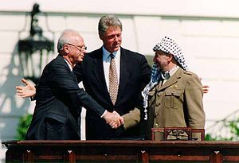
Oslo Accords (September 1993)
Israeli PM Yitzhak Rabin, US President Clinton,
and PLO Chairman Yasser Arafat

Slide 4
Oslo Accords, September 1993
Two State Solution
Israel recognized the PLO as the sole legitimate representative of the Palestinian people.
For its part the PLO once again recognized Israel’s right to exist in peace and security
Palestinian Authority Established
The sides agreed to the creation of a Palestinian Interim Self-Government Authority, which became known as the Palestinian Authority (PA), to represent the Palestinians in the West Bank and the Gaza Strip for a five-year transitional period leading to a permanent settlement.
It was under the Oslo Accords that Yasser Arafat was allowed to return to Palestine to take command of the PA in 1994.
No discussion on permanent borders, refugees, status of Jerusalem – no decisions on HOW Palestinians would gain state.
Notes:
Palestinian elections in 1996 for President and Parliament result in Arafat victory

Slide 5
Camp David (2000)
Israeli PM Ehud Barak, US President Clinton, and
PLO Chairman Yasser Arafat

Slide 6
Camp David 2000
Two State Solution (Most of West Bank & Gaza Strip)
Besides the U.S., all other nations were excluded from participating in the 2000 negotiations
Based on their experience of failed accords, Palestinian negotiators were careful not to sign a flawed peace agreement in 2000 as they had in 1993
No right of return, no Jerusalem
Halted by continued violence
Arafat blamed for walking away

Slide 7
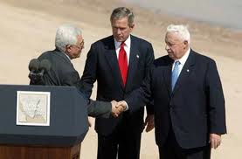
Roadmap for Peace (2003)

Slide 8
Roadmap for Peace (2003)
Prompted by Second Intifada which started in 2001
Palestinian rep. Abbas, US President, G.W. Bush, Israeli PM Ariel Sharon
Two-State Solution
Palestinians must stop violence
Palestinian leadership must issue statement reiterating Israel’s right to exist in peace and security
Palestinian Institution Building
Israel must take measures to improve humanitarian conditions
Israel must dismantle settlements built after March 2001 and freeze all settlement activity
International conference to plan the establishment of a Palestinian state
Future negotiations for comprehensive and permanent agreement to end conflict in 2005 through agreement by both parties and based on implementation of UN Security Council Resolutions 242, 338, and 1397
Notes:
UN resolution prompted by 2001 violence: "The Security Council,"Recalling all its previous relevant resolutions, in particular resolutions 242 (1967) and 338 (1973),"Affirming a vision of a region where two States, Israel and Palestine, live side by side within secure and recognized borders,

Slide 9
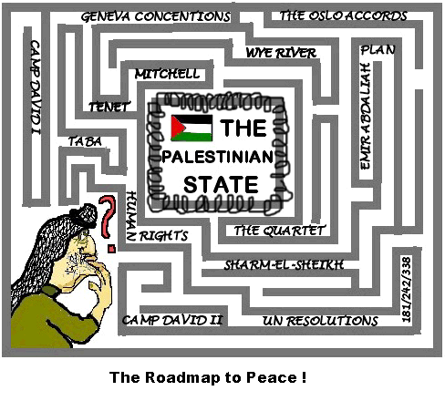

Slide 10
Discussion Question
Why are all of these peace negotiations failing?

